Slide 1
Face Attribute Classification using CNN
1.Jairus Sam Joseph (R20EF357)
2.Rayalla Anshita (R20EF374)
3.P Harshavardhan Reddy(R20EF368)
Prof. Dharshan L M
Date: 12/05/2023

Slide 2
Introduction
Objectives
Literature Review
Tools and Methodology
Data Augmentation
6. Results
7. Conclusion
8. References

Slide 3
Introduction
Facial attribute detection has a wide range of practical applications across various industries. It is useful in the fields of security, marketing, healthcare, human-computer interactions, personalization. As the technology advances, the applications will continue to grow. This project makes use of a model called MobileNet V2. MobileNet V2 is a popular deep neural network architecture that is designed for mobile and embedded vision applications. It was developed by Google researchers Mark Sandler, Andrew Howard, Menglong Zhu, Andrey Zhmoginov, and Liang-Chieh Chen and was released in 2018.
MobileNet V2 is an extension of the original MobileNet architecture, which was also developed by Google researchers. MobileNet V2 uses depthwise separable convolution, which involves performing convolution on each channel of the input separately before combining the results. This reduces the number of parameters in the model, making it smaller and more efficient for deployment on mobile devices. It has some key features such as Inverted Residuals, Linear Bottlenecks and a Squeeze-and-Excitation excitiation technique which helps the representational power.
The CelebA dataset is used and split into a Training and Testing dataset set. The Training dataset is used to train the model and uses Transfer Learning. The losses and accuracy are represented using graphs and a confusion matrix is used to visualize performance. We also make use of K-Fold Cross Validation Training.

Slide 4
objectives
Enhance the generalization ability of the model: Facial attribute detection models often suffer from poor generalization ability, which means that they perform well on the training data but poorly on unseen data. One objective is to improve the generalization ability of the model by incorporating techniques such as data augmentation, transfer learning, and domain adaptation.
Evaluate the ethical implications of facial attribute detection: Facial attribute detection has ethical implications, such as privacy and bias concerns. One objective is to evaluate these ethical implications and develop guidelines for the responsible use of facial attribute detection technology.
Using a combination of depthwise separable convolutions and linear bottlenecks to reduce the computational cost of the model while maintaining its expressive power. Depthwise separable convolutions split the standard convolution operation into a depthwise convolution followed by a pointwise convolution, which reduces the number of parameters and computations required.
Creating an application which is capable to running on devices with limited computational resources. The model should be suitable for mobile devices or embedded systems while retaining good accuracy and performance.

Slide 5
Literature review
SNo | Author Name, Publisher, Journal Name, Year | Title of the Paper | Data set & Environment setup | Objectives | Current Study (Algorithm/ Methodology) | Accuracy / Performance (Result Analysis)
1 | Richa singh | Face recognition of faces occluded by facial Accessories | 2D Log-Polar Gabor transform | disguised face images | This challenge uses dynamic neural network architecture. | extracted features are divided into frames. These frames are then matched with non disguised images using hamming distance.
2 | Dhamecha | Disguise detection and face recognition in visible and thermal spectrums | ITE based patch classifier | recognizing disguised faces in either visible or multi spectrum bands. | This framework consists of two phases ITE based Patch Classification and Patch-Based Face Recognition using LBP algorithm | .The proposed framework improves the accuracy when compared with the applications of SRC, LBP, and COTS

Slide 6
Literature review for Application
SNo | Author Name, Publisher, Journal Name, Year | Title of the Paper | Data set & Environment setup | Objectives | Current Study (Algorithm/ Methodology) | Accuracy / Performance (Result Analysis)
3 | Amarjot singh | Robust Face Recognition via Sparse Representation | Spatial Fusion Deep Convolutional Network. | Disguised Face Identification (DIC) and Disguised Face Classification Frameworks | The DIC framework describes the facial structure by using Spatial Fusion Deep Convolutional Network. | It is observed that, classification accuracy decreases as the number of disguise accessories increases in the test image
4 | Rui Min | Improving the Recognition of Faces Occluded by Facial Accessories | AR database | performance effects of facial occlusion in face recognition | classification of occluded/non occluded region, and LBP based face recognition | algorithm has been experimented using the AR database and yields a significant performance when compared with PCA, LBP, S-LNMF algorithms

Slide 7
Tools and Methodology
The project makes use of TensorFlow, MobileNet V2 Model, Google Colab and various other libraries. The project is done using Python.
Data Preparation: The first step in face attribute detection using TensorFlow is to collect a dataset of labeled images that includes the desired attributes. You can use existing datasets like the CelebA dataset or create your own dataset.
Model Selection: Once you have a dataset, you can choose a pre-trained model or train your own model using TensorFlow. Some popular pre-trained models for face attribute detection include Inception ResNet V1, Inception ResNet V2, and MobileNet.
Model Training: If you choose to train your own model, you will need to preprocess the data, split it into training and testing sets, and then train the model using TensorFlow's APIs. Training a model can take a significant amount of time, depending on the complexity of the model and the size of the dataset.
Model Evaluation: After training the model, you will need to evaluate its performance on a separate validation set. Common evaluation metrics for face attribute detection include accuracy, precision, recall, and F1 score.
Inference: Once you have a trained model, you can use it to detect face attributes in new images. To do this, you will need to preprocess the images, feed them into the model, and then extract the predicted attributes from the model's output.
The CelebA dataset is used and split into a Training and Testing dataset set where 8000 images are used as the Training set. The Training dataset is used to train the model and uses Transfer Learning. The losses and accuracy are represented using graphs and a confusion matrix is used to visualize performance.

Slide 8
Tools and Methodology
K-Fold cross-validation is a popular technique used in machine learning for model training and evaluation. It involves splitting the original dataset into K equal-sized parts, or folds, and using K-1 folds for training the model and the remaining fold for testing the model. This process is repeated K times, with each of the K folds used exactly once as the testing data. The final evaluation score is then computed as the average of the K individual evaluation scores.
The tools that were used were:
Google Colab
Python 3
TensorFlow
MobileNet V2
Seaborn
Matplotlib

Slide 9
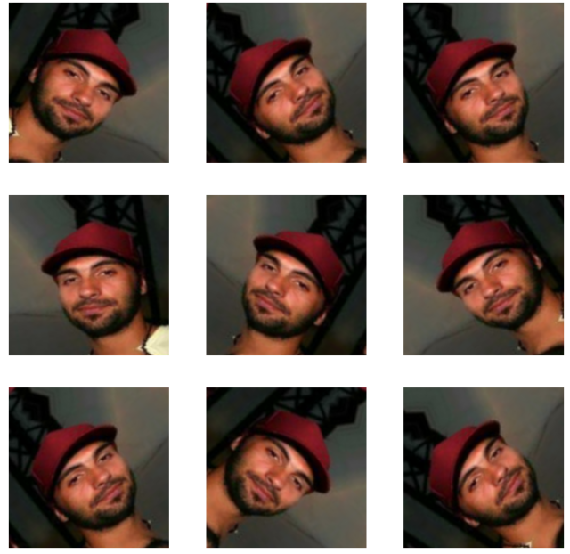
Data augmentation
Data augmentation is a technique used in machine learning and computer vision to artificially create training data from existing training data by applying transformations such as rotation, scaling, flipping, cropping, and other similar operations to the original data.
The main goal of data augmentation is to increase the amount of training data available so that the machine learning algorithms can learn more effectively and perform better on the test data. This is especially useful when the available training data is limited, and more data is needed to achieve good performance.
Data augmentation can also help in preventing overfitting, where the machine learning algorithm may learn to recognize specific examples in the training data rather than generalizing to new, unseen examples.
Therefore, data augmentation is an important technique for improving the accuracy of machine learning models, especially in applications where the amount of training data is limited.

Slide 10
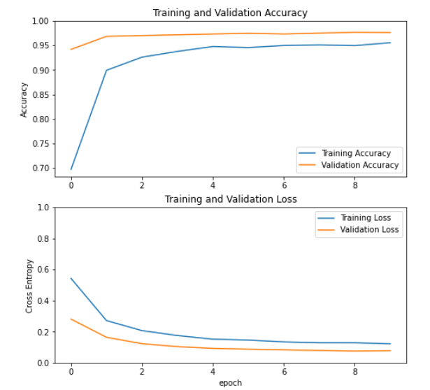
Results
The overall results of the project yield a rather high accuracy rate.
The accuracy and loss of the training and validation are visualized using graphs.

Slide 11
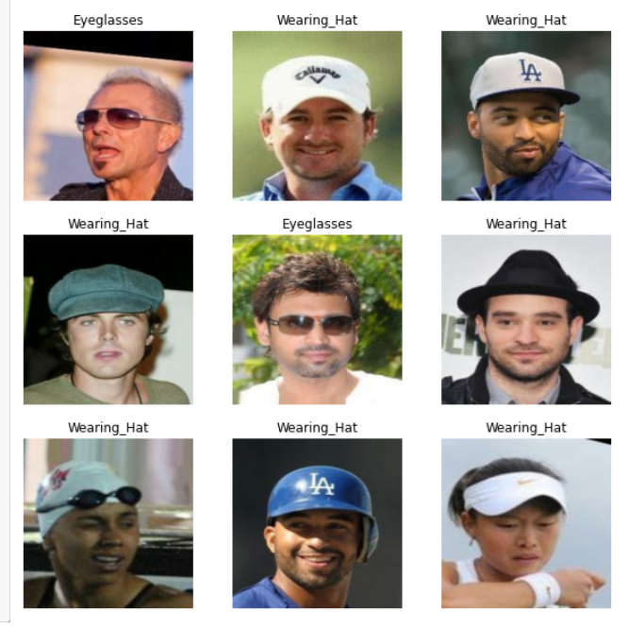
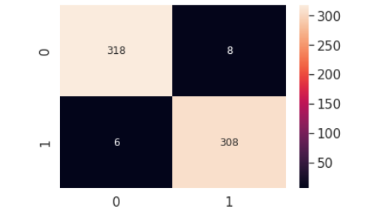
Results
The overall results of the project yield a rather high accuracy rate.
The images were accurately classified as “Wearing_hat” or “Eyeglasses”
A Confusion Matrix and heatmap are displayed to analyze the results.

Slide 12
Conclusion
A face attribute classification method that uses attribute-aware correlation map and gated convolutional neural networks (CNN) is proposed. The attribute-aware correlation map considers pixel-wise correlations between face image and attribute, and it is used to provide facial regions that are most relevant to the attributes. From these facial regions, the CNN columns extract relevant features conducive to attribute prediction. A gated layer is placed on top of the CNN columns such that appropriate CNN columns contribute to appropriate attribute prediction. Experimental results on the LFW dataset with 40 attribute classes indicate significant performance improvement.
We use MobilNet V2 from Google which is a CNN that is 53 layers deep. While the model has various benefits, it suffers from some drawbacks such as Small filter sizes, limited flexibility, compatibility issues and limited capacity.
The improvements that could be made is the inclusion of more attributes to be identified. The project could be extended to include facial identification, emotion detection and more. Other models could also be used to increase accuracy and deal with the drawbacks of MobileNet V2.

Slide 13
references
Rui Min, Abdenour Hadid, Jean-Luc Dugelay, ”Improving the Recognition of Faces Occluded by Facial Accessories”, IEEE conference on Face and Gesture, pp. 442 – 447, 2011.
John wright, Allen Y. Yang, Arvind Ganesh, S. Shankar Shastry, and Yi Ma, “ Robust Face Recognition via Sparse Representation”, IEEE Transaction on Pattern Analysis and Machine Intelligence, Volume: 31, No: 2, pp. 1 – 18, 2009.
Richa Singh, Mayank Vatsa and AfzelNoore, “Face recognition with disguise and single gallery images”, Image and Vision Computing, Volume: 27, Issue: 3, pp. 245 – 257, 2009.
Tejas I. Dhamecha, Aastha Nigam, Richa Singh, and Mayank Vatsa, ”Disguise Detection and Face Recognition in Visible and Thermal Spectrums”, IEEE International Conference on Biometrics, pp. 1 - 8, 2013.
Face attribute classification using attribute-aware correlation map and gated convolutional neural networks
Sunghun Kang;Donghoon Lee;Chang D. Yoo
2015 IEEE International Conference on Image Processing (ICIP)

